Slide 1
Machine Learning 5/5
2015.12.31(목)
박지현

Slide 2
Recommender Systems
Predicting Movie Ratings
Collaborative Filtering
Low Rank Matrix Factorization
Large Scale Machine Learning
Gradient Descent with Large Datasets
Advanced Topics
Application Example: Photo OCR
Photo OCR

Slide 3
Recommender Systems
Predicting Movie Ratings
Collaborative Filtering
Low Rank Matrix Factorization
Large Scale Machine Learning
Gradient Descent with Large Datasets
Advanced Topics
Application Example: Photo OCR
Photo OCR

Slide 4
Recommender Systems
상세 내용

Slide 5
Recommender Systems
Predicting Movie Ratings
Collaborative Filtering
Low Rank Matrix Factorization
Large Scale Machine Learning
Gradient Descent with Large Datasets
Advanced Topics
Application Example: Photo OCR
Photo OCR

Slide 6
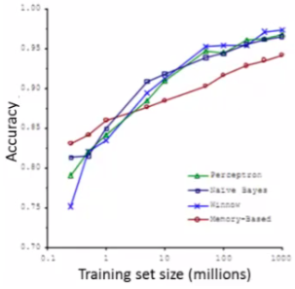
Large Scale Machine Learning
상세 내용
Learning with large datasets
Why large datasets?
One of best ways to get high performance is take a low bias algorithm and train it on a lot of data
e.g. Classification between confusable words
We saw that so long as you feed an algorithm lots of data they all perform pretty similarly

Slide 7

Large Scale Machine Learning
상세 내용
Learning with large datasets
But learning with large datasets comes with its own computational problems
For example, say we have a data set where m = 100, 000, 000 This is pretty realistic for many datasets
Census data
Website traffic data
How do we train a logistic regression model on such a big system?
So you have to sum over 100,000,000 terms per step of gradient descent
Because of the computational cost of this massive summation, we'll look at more efficient ways around this
Either using a different approach
Optimizing to avoid the summation

Slide 8
Large Scale Machine Learning
상세 내용

Slide 9
Large Scale Machine Learning
상세 내용
Stochastic Gradient Descent

Slide 10
Large Scale Machine Learning
상세 내용

Slide 11
Large Scale Machine Learning
상세 내용

Slide 12
Large Scale Machine Learning
상세 내용

Slide 13
Large Scale Machine Learning
상세 내용

Slide 14
Large Scale Machine Learning
상세 내용

Slide 15
Large Scale Machine Learning
상세 내용

Slide 16
Large Scale Machine Learning
상세 내용

Slide 17
Large Scale Machine Learning
상세 내용

Slide 18
Recommender Systems
Predicting Movie Ratings
Collaborative Filtering
Low Rank Matrix Factorization
Large Scale Machine Learning
Gradient Descent with Large Datasets
Advanced Topics
Application Example: Photo OCR
Photo OCR

Slide 19
Photo OCR
상세 내용

